Slide 1
2016 Annual Meeting
“Bank Financing & Risk Management –
A Recap & Look Forward”
June 3, 2016

Slide 2
Panel Members
Andrew Nesi, Executive Vice President
(203) 418-9057
anesi@hjsims.com
Walter Unangst, Senior Vice President
(610) 832-1764
walter.unangst@fnfg.com
Ron Krauskopf, Senior Vice President
(973) 474-9611
rkrauskopf@myinvestorsbank.com
James Engel, Principal
(518) 392-5010
jengel@kensington-advisors.com

Slide 3
LeadingAge New Jersey – 2016 Annual Meeting
Setting the Stage

Slide 4
Setting the Stage
Tax Exempt Bonds Purchased by Commercial Banks Have Become A Significant Financing Tool Coming Out of the Great Recession
Supplanted Letters of Credit Supporting Variable Rate Bonds
Provides a Source of Low Cost Capital
Longer Term than L/C VRB’s, But Not As Long as Municipal Bonds
No Debt Service Reserve Fund Requirement and Draw Down Feature Reduces Amount of Debt Required
Restrictive Covenants and Loan-to-Value Constraints Remain
Direct Bank Purchase of Tax Exempt Bonds Typically Carries Variable Interest Rate
Swapped to Fixed Rate Either by Choice or Requirement
Derivatives Bring Baggage…and Regulations
Can They Co-Exist with Municipal Bonds?

Slide 5
Setting the Stage – HJ Sims
Founded in 1935 on Wall Street
Local Presence
Focus on municipal (tax-exempt) revenue financing (bond, bank & mortgage)
Focus on senior living, healthcare, not-for-profit, education, and human services
Extensive Capital Sourcing and Bond Distribution Capabilities
Focus on high yield tax-exempt debt for retail (individual) + institutional investors
$1.9bn assets under management (5,600 retail accounts)
Provide financial advisory and underwriting services
$1.8 bn of senior living financings in 125 transactions for NJ clients
Dedicated retail sales offices in seven locations targeting high net worth investors
Extensive commercial bank relationships for direct loans and credit support
Two NJ offices providing investment banking, HUD and institutional/retail investment services

Slide 6
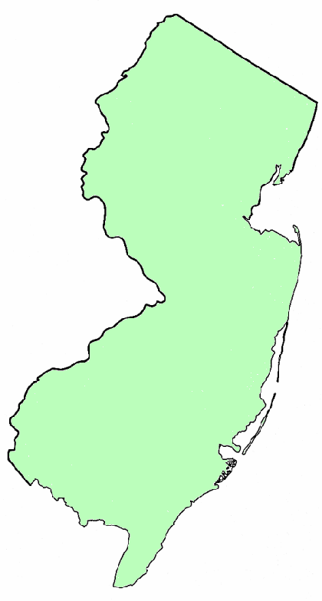
Setting the Stage – HJ Sims
Bristol Glen (UMH), Newton
Wanaque Convalescent Center, Wanaque
Christian Health Care Center, Wyckoff
Cedar Crest, Pompton Plains
Crane’s Mill, West Caldwell
Job Haines Home, Bloomfield
Winchester Gardens, Maplewood
Fellowship Village, Bernardsville
Abbey Woods at Delbarton, Morristown
Delaire Nursing and Convalescent Center, Linden
Stone Arch Nursing Home, Union
The Workmen’s Circle Home, Elizabeth
Bridgewater: - Arbor Glen of Bridgewater
- The Avalon at Bridgewater
- Bridgeway Convalescent Center
Reformed Church Home, Old Bridge
Maplewood Convalescent Center, Berkeley Heights
Edison Estates North Rehabilitation and Convalescent Center, South Plainfield
Presbyterian Home at Montgomery, Montgomery
The Avalon at Hillsborough, Hillsborough
Springpoint Senior Living (Obligated Group), Princeton
Trenton
Lions Gate, Voorhees
Collingswood Manor (UMH), Collingswood
- The Millhouse
Hamilton Continuing Care, Hamilton
Burnt Tavern, Brick
Cadbury at Cherry Hill, Cherry Hill
Green Acres Manor, Toms River
Moorestown: - Lutheran Home at Moorestown
- The Evergreens
Leisure Park, Lakewood
Manor by the Sea (UMH), Neptune
Greenbriar East Nursing Center, Deptford
The Meadows & Meadow View Nursing and Convalescent Center, Williamstown
Greenbriar Nursing Center of Hammonton, Hammonton
Friends Home at Woodstown, Woodstown
Seacrest Village Care Center, Little Egg Harbor
Galloway: - Galloway Healthcare
- Seashore Gardens Living Center
Jewish Community Center of Atlantic County, Margate
The Shores at Wesley Manor (UMH), Ocean City
Middletown: - Courthouse Convalescent Center
- Eastern Shore Nursing and Convalescent Center Project
6

Slide 7
Setting the Stage – First Niagara
First Niagara started focused healthcare group in 2009
2010 – 2015 was a period of substantial growth in terms of dedicated personnel and relationships
Seniors Housing and Long Term Care represents in excess of 50% of the total healthcare portfolio
Construction lending historically represents 10 – 20% of the portfolio
Non-Profits represent approximately 50% of all relationships

Slide 8
Setting the Stage – Investors Bank
Founded in 1926
Largest bank headquartered in New Jersey
More than 145 locations
Over $20.8 billion in assets currently - plan to grow to $45 billion over the next 5 years
Entered commercial lending in 2007
Introduced healthcare lending October 2012 via recruitment of established team
One of the fastest growing units within the bank
Over $500 million in total commitments
Processing $200-300 million in new credits annually
Primary lending footprint: NJ, NY, PA, CT.
Senior Living, Long Term Care, and Not for Profits represent approx. 60% of the portfolio
Investors Bank Foundation - provides tax free grants to Not for Profit Organizations
Funded more than $60 million into the Foundation, with over $15 million of pledged support
Life Plan Communities (CCRCs) | Assisted Living/Memory Care
Skilled Nursing/Post Acute | Independent Living/Affordable Housing
Adult Day Care/ | Behavioral/Substance Abuse
Tax Exempt and Taxable Financing | Construction Lending / Cash Management

Slide 9
Setting the Stage – Kensington Capital Advisors
Independent derivative advisory firm founded in 2004
5 derivative specialists with offices in NY & NC
4 have worked on trading floors for top tier banks with combined experience of over 85 years
Have advised on over 2000 transactions totaling over $27 billion in hedge notional
Specialize in derivative:
Modeling & pricing
Accounting
Litigation support
Dodd Frank compliance

Slide 10
Setting the Stage – Kensington Capital Advisors
Tax-Exempt Interest Rate Swap Activity (2010 – 2016)
Large Municipal Issuers – swap activity has decreased post-Lehman bankruptcy
Increase in Direct Purchase Bank Financing
Historically low rates and longer credit commitments

Slide 11
LeadingAge New Jersey – 2016 Annual Meeting
Financing Criteria

Slide 12
Financing Criteria – Key Factors
Key Criteria Widely Known
Debt Service Coverage
Liquidity
Occupancy
Market / Competition
Loan to Value Caps
Any Additional Criteria or Shift in Importance Over Past Several Years?
Equity Requirements – What is Equity?
Any Rebalancing of Portfolio Away From Certain Sectors and Towards Others?
For Profit vs. Not-for-Profit Bias?

Slide 13
Financing Criteria – Key Factors
Additional Considerations
Ancillary Business Requirements
Breadth of Services
Operating Accounts, etc.
Investment Advisory
On Site Branch
Any Hard & Fast Rules?
Interplay Between Bank Debt & Public Bond Debt
Majority vs. Minority Stakes
Intercreditor Requirements

Slide 14
LeadingAge New Jersey – 2016 Annual Meeting
Structuring Considerations & Options

Slide 15
Structuring Considerations & Options
Shift in Tax Exempt Debt Products
Yesterday: Letters of Credit and Variable Rate Bonds
Today: Direct Bank Purchase of Tax Exempt Bonds
Why?
Any Role for Taxable Debt?
Bank Qualified vs. Non-Bank Qualified?
Term (Hold Period)
Is 10 Years Standard?
Circumstances for Longer or Shorter Terms

Slide 16
Structuring Considerations & Options
Interest Rate Mode
Variable vs. Fixed
When is Swap Required?
Fixed vs. Variable-to-Fixed via Swap
Availability
Drawdown Feature
Future Projects
Conditions Precedent

Slide 17
Structuring Considerations & Options
Swap Considerations
Why/When is Swap Advisor Required?
Principal Duties
Compensation
Any Other Products?
Integration
Are Swaps Secured?
Risks of Mark-to-Market
Any Way to Avoid Penalty?
What’s an ISDA Agreement?
Parties Involved
Key Aspects to Understand

Slide 18
Comparison of Financing Alternatives
 | Bond Financing | Bank Financing
Lowest Cost of Capital |  | X
Interest Rate or Refinancing Risk |  | X
Fast and Efficient Closing |  | X
Minimize Negative Arbitrage |  | X
Debt Service Reserve Requirement | X
Loan to Value Constraints |  | X
Ancillary Business Requirement |  | X
Flexible Covenants | X

Slide 19
LeadingAge New Jersey – 2016 Annual Meeting
Ongoing Debt Management

Slide 20
Ongoing Debt Management
Ongoing Performance Monitoring
Reporting Requirements
Periodic Credit Review
Results Not As Expected
What Happens Next
Should I Be Concerned?
Relationship Management
Expectations Regarding Meetings
Access to Senior Bank Staff

Slide 21
Ongoing Debt Management
Ongoing Interest Rate Risk Management
Debt Swapped – Out of Sight/Out of Mind?
Blend and Extend
Key Metrics or Events to Consider
Any Changes in Market Conditions or Regulations that Could Impact Derivative Market?

Slide 22
LeadingAge New Jersey – 2016 Annual Meeting
THANK YOU!

