Slide 1
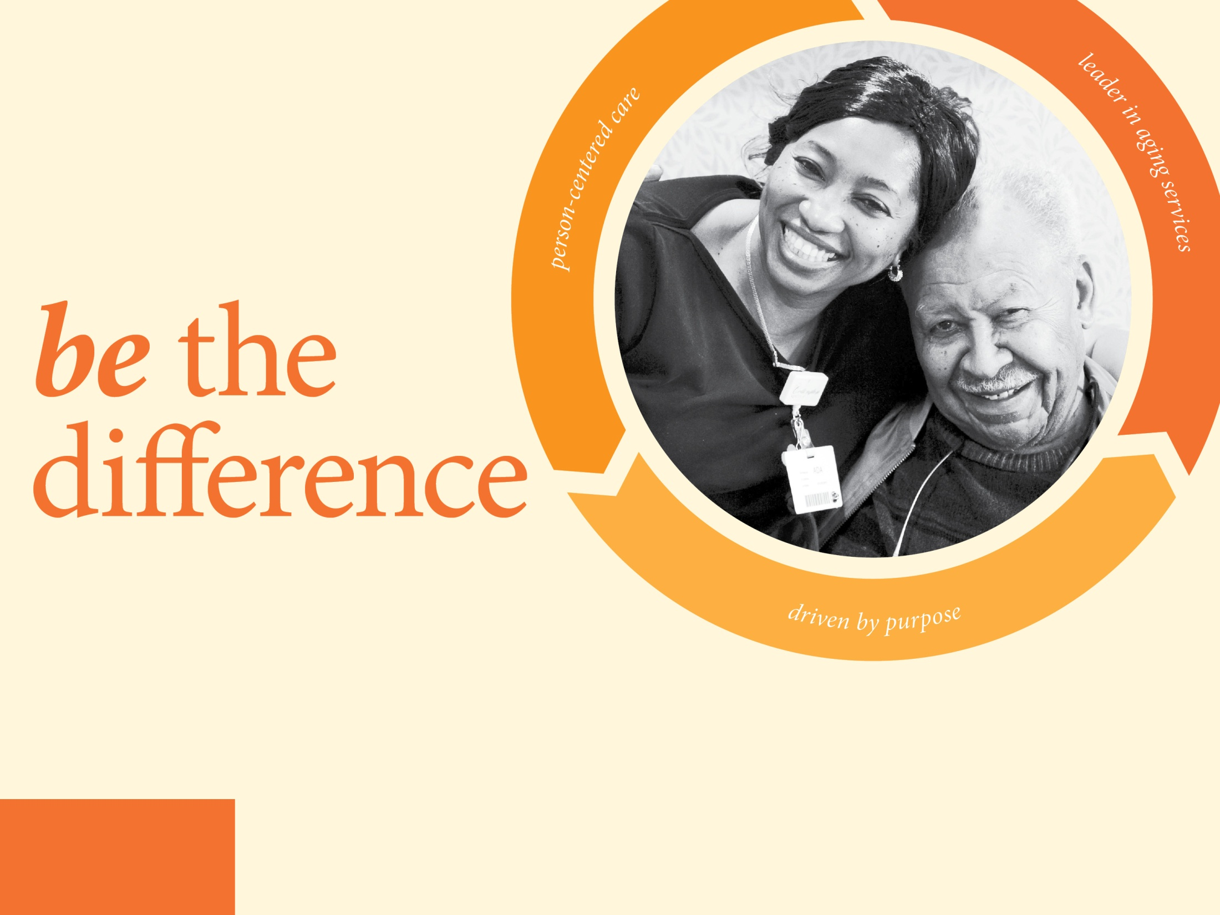

LeadingAge New Jersey Annual Conference
June 1-3, 2016
Harrah’s, Atlantic City

Slide 2

Behavior as Communication:
Using the Habilitation Model to Work with Residents with Alzheimer’s
Caren Silverlieb, MMHS
Director of Strategic Planning and Partnerships
Jewish Community Housing for the Elderly

Slide 3
Quick Review

Slide 4
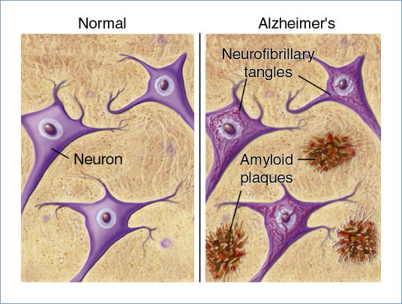
What’s Happening in the Brain
Plaques
Beta amyloid protein accumulates forming dark clumps outside neurons
These cells are most involved with thinking, sensing, perceiving, feeling, planning, language, movement…
These clumps cause brain cells to die

Slide 5
What’s Happening in the Brain
Tangles
Tau protein erodes the walls of the neurons and cause neurofibrillary tangles

Slide 6
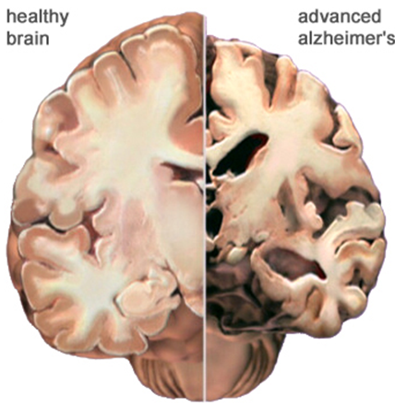
What’s Happening in the Brain
Healthy brain weighs 3 lbs.
Diseased brain weighs 1 lb.
Length of decline 3-18 yrs.
Neuropathology begins 10-15 years prior to noticeable changes

Slide 7
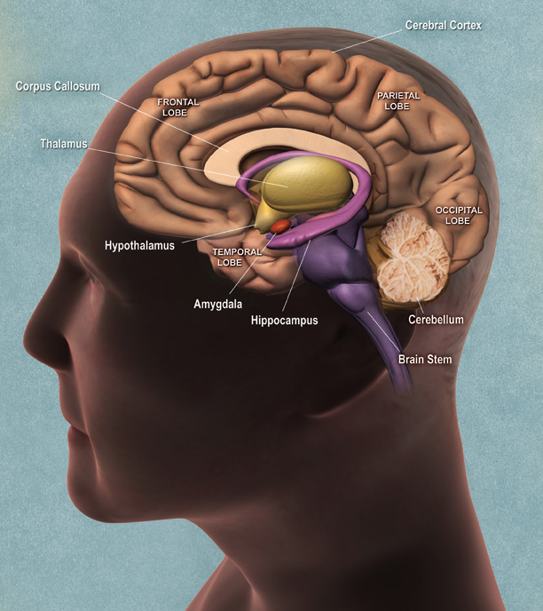
What’s Happening in the Brain
Hippocampus
The disease starts in the area of the brain just above the ears on both sides of the brain, called the Hippocampus.

Slide 8
What’s Happening in the Brain
Hippocampus
Takes in new information
Puts that information (comes in through the senses) in a form that the brain can use
Compares new information to old
Labels and files information
With Alzheimer’s, the Hippocampus is broken

Slide 9
What’s Happening in the Brain
Amygdala
Almond-shaped groups of nuclei located deep and medially within the temporal lobes of the brain
Remains pretty much intact long into the progression of the disease

Slide 10
What’s Happening in the Brain
Amygdala
Involved with emotions:
the ability to hold an emotion
the ability to perceive emotions
the ability to feel emotions
the need to evoke and receive emotions in others
This is why the Habilitation Model focuses on emotions!

Slide 11
Habilitation - not Rehabilitation!
Rehabilitation Therapy helps a person to re-learn abilities they’ve lost
Habilitation Therapy creates a milieu around the person:
To promote positive emotion
To compensate for sensory losses
To make the most of remaining skills and abilities
For staff to speak the same language of Habilitation

Slide 12
The Habilitation Model
Knowing and Understanding the Individual
Behavior as the Resident’s Communication with Us
Our Communication with the Resident
Purposeful Engagement
Physical Environment
Our Approach to Personal Care

Slide 13
What We’ll Talk About Today
Internal/External triggers cause negative behaviors
Behavior that’s challenging vs. “problematic”
When behavior poses an immediate risk
Behavior detectives and teams
Tracking negative behavior

Slide 14
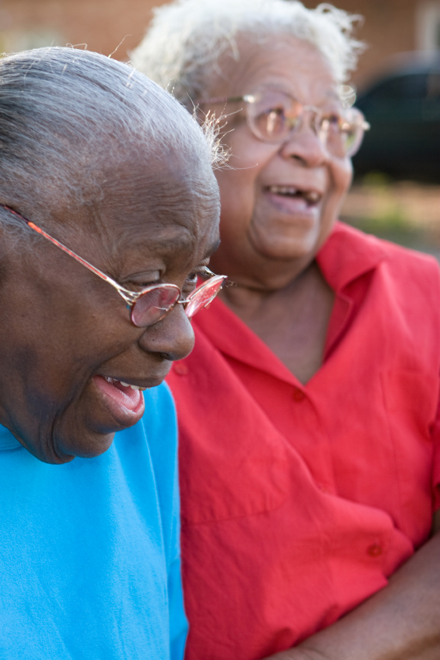
We Can Help By
Limiting distractions
Showing interest and being supportive
Offering comfort and reassurance
Being patient; giving time to respond
Offering a guess

Slide 15
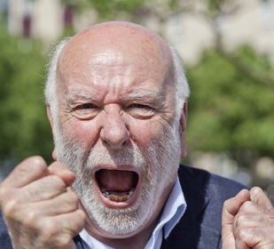
Behavior as Communication

Slide 16
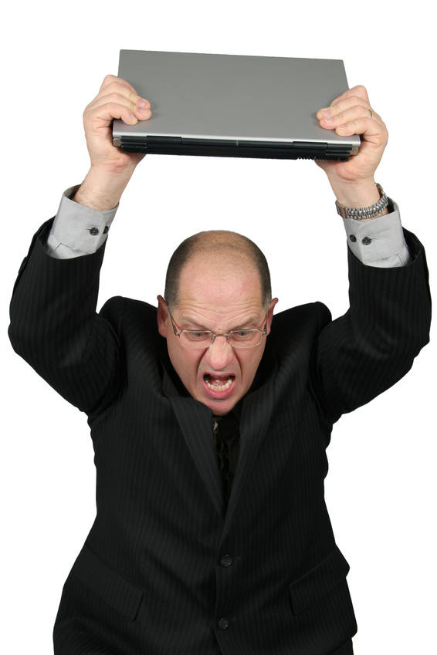

Slide 17


Slide 18
Behavior is not random!
Behavior may be the only way
the resident has to communicate.

Slide 19
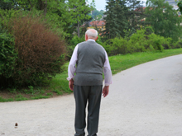
Common Challenging Behaviors
Rummaging or searching
Hiding or losing things
Pacing or wandering
Repeating
Resisting or refusing care
Sundowning
Hallucinating, Paranoia, Delusions

Slide 20
Triggers
Internal
Something happening in the mind or body of the person
External
Something that is happening around them or to them

Slide 21
What could be the cause of the behavior?
The Behavior
She is rummaging in the closet...
He urinates behind the plant…
She is talking – we see no one…
He wanders around constantly...
She refuses a shower...
Cause or Trigger
because she is looking for her purse
because he needs the bathroom now
because of hallucinations
because he has nothing to do
because the bathroom is too cold

Slide 22
What could be the cause of the behavior?
The Behavior
She is rummaging in the closet...
He urinates behind the plant…
She is talking to no one...
He wanders around constantly...
She refuses a shower...
Cause or Trigger
because she is looking for her purse I
because he needs the bathroom now I
because of hallucinations I
because he has nothing to do E
because the bathroom is too cold E

Slide 23
When does a challenging behavior become a
“problem behavior”?

Slide 24
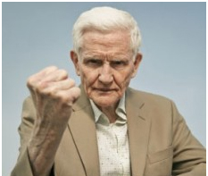
A problem behavior is a health or safety risk for the person with dementia or for someone else.

Slide 25
Is this a Problem Behavior?
Wearing mismatched clothes
Asking repeated questions
Pacing or wandering
Refusing a bath or shower
Tries to hit you
No
No
Maybe
Maybe
YES!

Slide 26
Responding to Problem Behavior
They are doing something that is a potential danger to themselves or others:
Calmly get their attention
Connect with them, engage them in general conversation
Casually attempt to take the dangerous item (“Joe, can I help you with that?”)
Redirect them to another activity
Escort them away from the unsafe area

Slide 27
Responding to Problem Behavior
They are going to hit or have already hit you:
Do not hit back
Step back and get out of their reach
Keep calm and do not raise your voice
Say something like, “That hurt.” “It hurts when you hit me.” “Ouch! You slapped my face.”
Connect with their feelings, not their actions
If possible get help
If safe, leave them alone for a short while or redirect them to another activity

Slide 28
Responding to Problem Behavior
They are going to hit or have already hit someone else:
Calmly get their attention on you so they stop advancing
Say something like, “Stop Joe.”; or “It hurts when you hit, slap, kick, etc.”
Respond to their feeling, not their words or actions
Reassure and calm them
Look to see if their body language shows they are relaxing
Connect with them and redirect them away from the other person

Slide 29
The Habilitation Model
Knowing and Understanding the Individual
Behavior as the Resident’s Communication with Us
Our Communication with the Resident
Purposeful Engagement
Physical Environment
Our Approach to Personal Care

Slide 30
Habilitation Helps Us Find Solutions
We can find answers to challenging behaviors through the domains of Habilitation:
  Should we change our communication?
  Should we make a change in their environment?
  Should we change our approach to personal care?
  Should we engage them in an activity
  Should we find something purposeful for them to do?

Slide 31
Investigating Behavior
At times we need to investigate to try to resolve a behavior. We want to learn:
    The cause of the behavior (the Trigger)
    What to change (the Trigger tells us)
This is hard to do as the behavior is happening
Afterward, step back, look for clues, and come up with a possible solution

Slide 32
Behavior Log
When (date, time) did the behavior happen? | What happened right before the behavior? What was the behavior? Where did the behavior happen? Who was there? | What are the Possible Triggers or Causes? | What Habilitation Concept Can Be Tried to Change the Behavior?

Slide 33

Additional Questions about the Behavior
Is there a pattern?
Was it caused by a communication problem?
Was it caused by the environment?
Was it caused by our approach
to care?
Was it caused by a lack of activity?
Could it be caused by an internal trigger?

Slide 34
Behavior as Communication
When we learn the cause, and make a change in our response, we’ve listened to what their behavior is telling us.
This is Behavior as Communication!

Slide 35
Caren Silverlieb, MMHS
Director of Strategic Planning and Partnerships
(617) 912-8403
csilverlieb@jche.org
Tips and Techniques for Supporting Residents with Alzheimer’s Disease Using the Habilitation Model: A Guide for Staff in Independent Senior Housing can be found at:
jche.org/guide

