Slide 1
CentENarians to boomers
Bridging the Generation Gap

Slide 2
Today’s senior communities house seniors from three separate generations. From oldest to youngest: the Greatest Generation, the Silent Generation and Baby Boomers. Learn the differences between these generations and how they are impacting the evolution of senior living today.

Slide 3
There are three commonly recognized generations that make up the aging population and inhabit the senior living communities of today. While the exact years that separate these generations vary from source to source, the rough time periods are widely agreed upon.

Slide 4
Named by Tom Brokaw who wrote: “It is, I believe, the greatest generation any society has ever produced.” Grew up during the Great Depression Many served in the armed forces during World War II Racial and ethnic minorities of the generation, especially African Americans, endured extreme prejudice and abuse, including shameful institutionalized racism that was the Jim Crow Law and segregation
The Greatest Generation
(1901-1925)

Slide 5
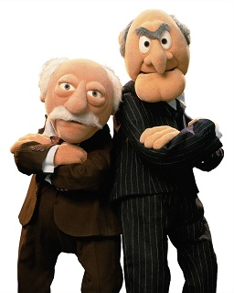

Slide 6
Characteristics:
Perseverance in face of adversity
Courageousness
Frugal spending habits
Traditional values
Prejudices still exist in many

Slide 7
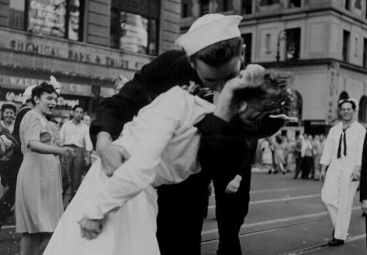

Slide 8
Also known as the Post-War Generation, the “Lucky Few” and “The Traditionalists” May have grown up during Great Depression but generally too young to have served in Second World War Most Korean War veterans are Silent Generation members Silent Generation African Americans also grew up during the era of Jim Crow but fought for and achieved significant strides in civil rights during their adulthood
The Silent Generation
(1926-1944)

Slide 9
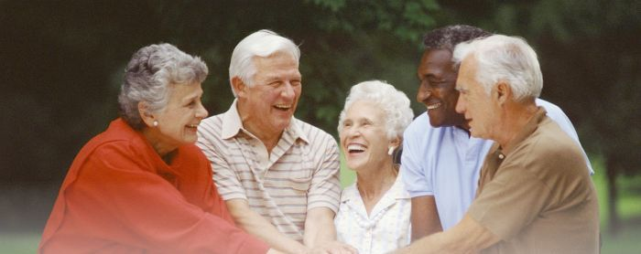

Slide 10
Characteristics:
Hardworking
Logical
Loyal
Traditional outlook and clear sense of right and wrong
Conformist

Slide 11
Came of age during the civil rights movement and desegregation Witnessed Vietnam and corresponding anti-war movement, with many members of this generation having been drafted into the service Ushered in a more permissive and socially liberal culture
The Baby Boomers
(1945-1964)

Slide 13
Characteristics:
Independent
Competitive
May have more open-minded social values than older generations
Focused on health and wellness
Values individuality

Slide 14
At assisted living communities, the majority of residents are members of the Silent Generation and Greatest Generation. A Center for Disease Control (CDC) report, National Survey of Residential Care Facilities, found that more than one half of residents at assisted living communities and residential care homes are over the age of 85. The same report that found that 40% need help with at least three or more activities of daily living, such as toileting, eating, dressing and bathing.

Slide 15
But, there are ways generational differences can be seen in senior living today. A Place for Mom Senior Living Advisor, David Grossman, noted that the Silent Generation, including educated and independent women who are now retired, are demanding opportunities for enrichment and education throughout their life that older generations did not demand. The generation of elders who reside in today’s senior communities don’t see assisted living as the end of the road, but rather a place to continue learning and enriching the body and soul:

Slide 16
Because residents under 74 years of age make up just 20% of assisted living residents, and only 9% of residents under 65, it’s clear that the Boomers have yet to made themselves felt in senior living. But, this will be changing rapidly as people are turning 65+ in record numbers each day.

Slide 17
The Baby Boomer Generation is a tidal wave which will soon engulf the senior living industry. As of 2010, 13% of the U.S. population is 65+. The U.S. Census Bureau projects that “by 2030, all of the baby boomers will have moved into the ranks of the older population. This will result in a shift in the age structure, from 13 percent of the population aged 65 and older in 2010 to 19 percent in 2030.”

Slide 18
When those residents arrive, senior communities may have to deal with issues they’ve never dealt with before, some of which are rather sensitive. Communities are only beginning to explore policies regarding sexual activity among residents, and one can speculate that Boomers, who grew up in the sexually liberated 1960’s, will have much different attitudes about sex than current senior living residents.

Slide 19
The 1960’s, formative years for many Boomers, were also a time of prevalent drug experimentation and many certainly familiar with marijuana. According to Gallup, by 1985, at least one third of U.S. adults had tried marijuana at least once. And now in 2018, with several states permitting medical use and some states additionally allowing recreational use, assisted living communities and other long-term care providers will also have to form policies around the substance, which the New York Times reports only a few communities have begun to do.

Slide 20
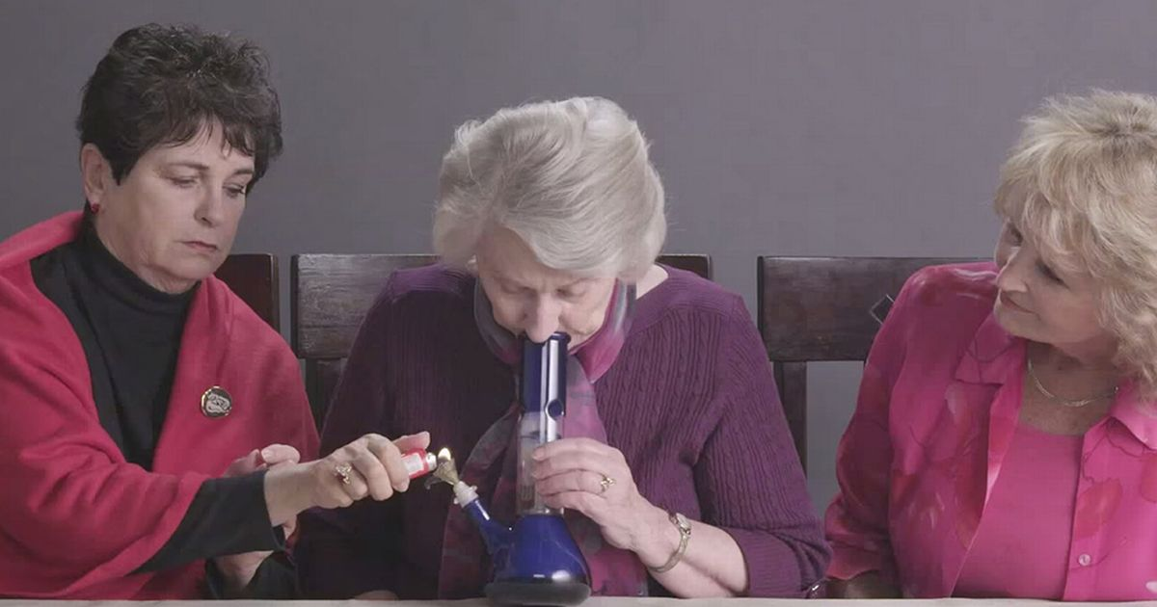

Slide 21
An individual’s age is one of the most common predictors of differences in attitudes and behaviors. On issues ranging from foreign affairs to social policy, age differences in attitudes can be some of the widest and most illuminating. Age denotes two important characteristics about an individual: their place in the life cycle – whether a young adult, middle-aged parent or retiree – and their membership in a cohort of individuals who were born at a similar time.

Slide 22
The Baby Boom generation is an example of a generation that is largely delineated by demography. Its oldest members were part of the spike in fertility that began in 1946, right after the end of World War II. Its youngest members were born in 1964, shortly before a significant decline in fertility that occurred after the birth control pill first went on the market.

Slide 23
Understanding BOTH sides and where they come from is key to resolving conflicts. As professionals, we cannot take sides because we identify more with one than another. Knowing who you’re dealing with will make it easier to resolve conflicts in a way that leaves both parties feeling satisfied.

Slide 24
Attitudes towards many different social issues vary between the generations. Things like politics, abortion, sex, drug use, marriage, sexual orientation, and many other issues can become the source of heated debates between seniors of different generations.

Slide 25
The divide becomes much greater in subsidized housing that includes seniors and also families with Generation Xers, and Millennials. These two generations are extremely entitled, and show little to no respect to older generations. In turn the older generations have an expectation of respect because of how they were raised. So you can see where the conflicts might come up in this environment.

