Slide 1
CULTURALLY COMPETENT CARE ADDRESSING THE NEEDS OF LGBTQ SENIORS

Slide 2
PANELISTS
JORDAN STROHL, Administrator, The Actors Fund Home
MARIA PEREZ, Administrator & CEO, Methodist Home for Nursing and Rehabilitation
STEVE LEONE Principal, Spiezle Architectural Group
MODERATOR
FRANK SHERMAN, Director of Sustainability, Spiezle Architectural Group

Slide 3
A Growing Population of LGBTQ Older Adults

Slide 4
Sources: Karen I. Fredriksen-Goldsen, "The Future of LGBT+ Aging: A Blueprint for Action in Services, Policies, and Research," Generations: Journal of the American Society on Aging 40, no. 2 (2016); Hyun-Jun Kim, et al., "A Collaboration for Health and Wellness: GRIOT Circle and Caring and Aging with Pride," Generations: Journal of the American Society on Aging 40, no 2 (2016); Charles A. Emlet, "Social Economic, and Health Disparities Among LGBT Older Adults," Generations: Journal of the American Society on Aging 40, no 2 (2016).
Graphics Courtesy of Movement Advancement Project

Slide 5
Graphics Courtesy of Movement Advancement Project

Slide 6
Key Challenges For LGBTQ Older Adults
A Lifetime of Discrimination and Lack Of Legal and Social Recognition
Reliance on Chosen Family
Lack of Competent Inclusive Healthcare

Slide 7
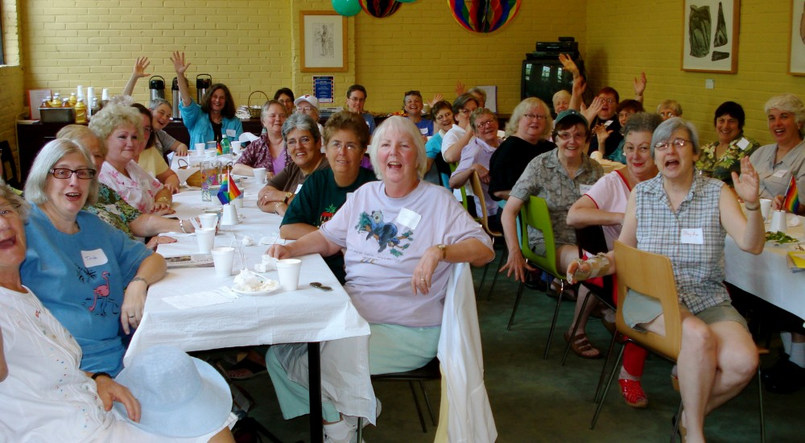
Photo Courtesy of Fenway Institute, fenwayfocus.com

Slide 8
Cultural Diversity of the LGBT Community

Slide 9
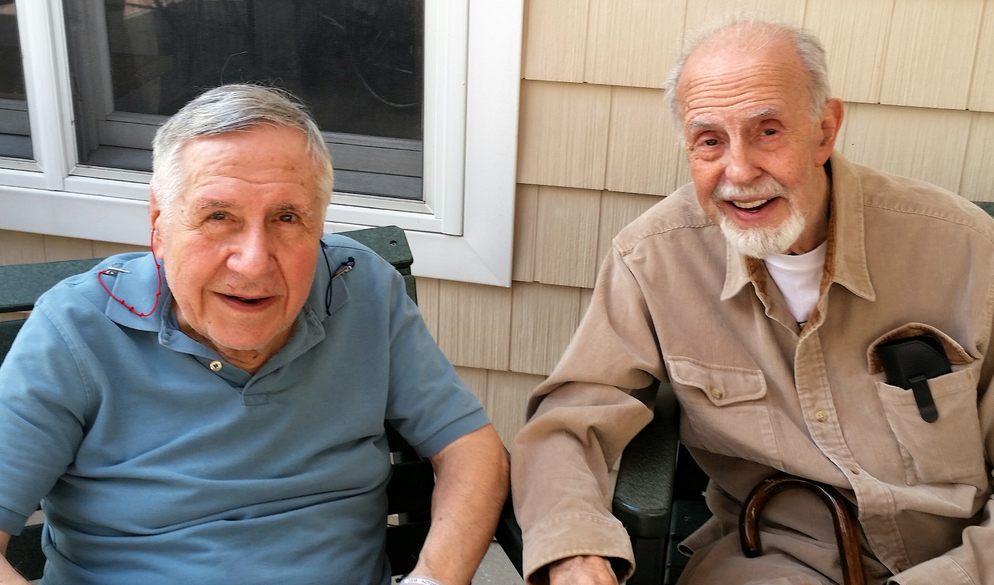
Photo Courtesy of Fenway Institute, fenwayfocus.com

Slide 10
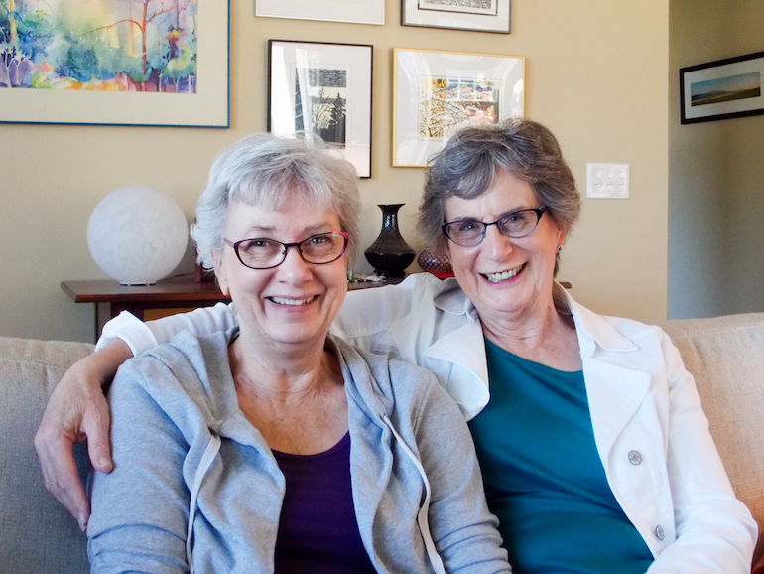
Photo Courtesy of Kaiser Health News

Slide 11
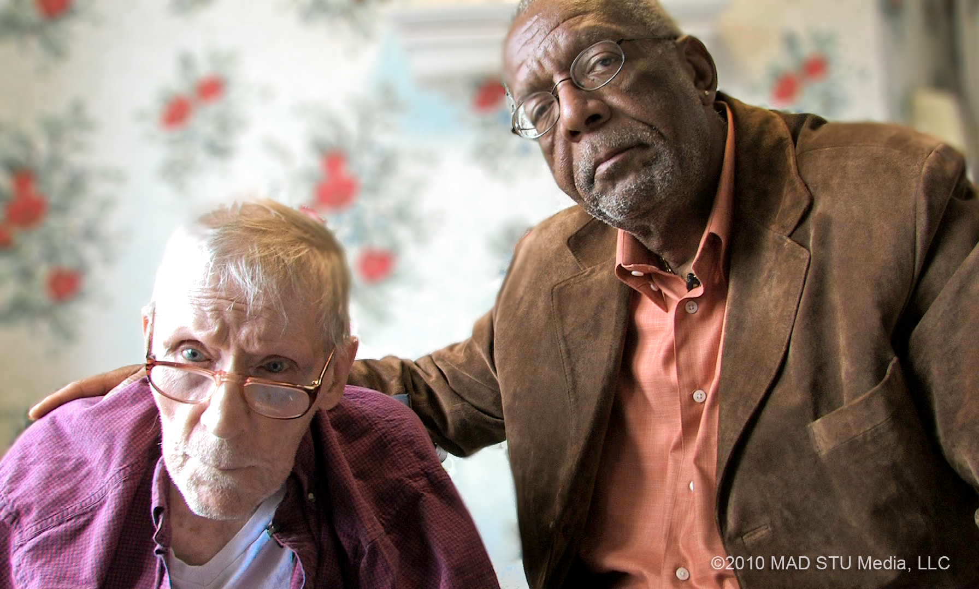

Slide 12
Myths and Realities of Caring for LGBT Seniors

Slide 13
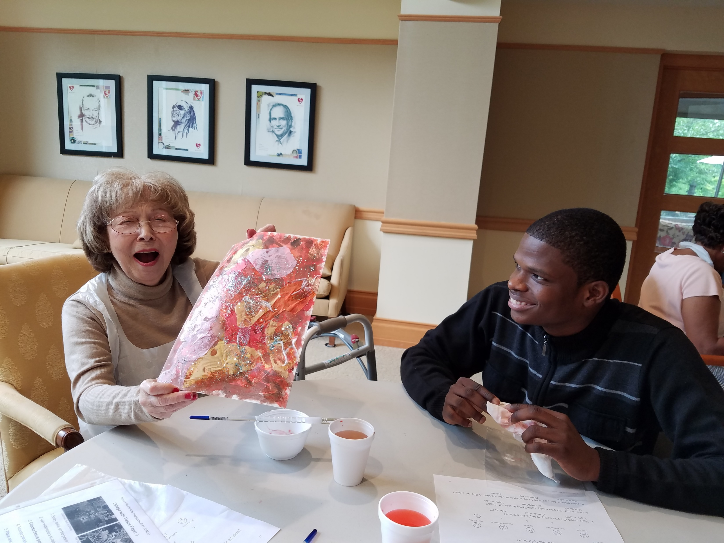
Photo Courtesy of Methodist Home

Slide 14
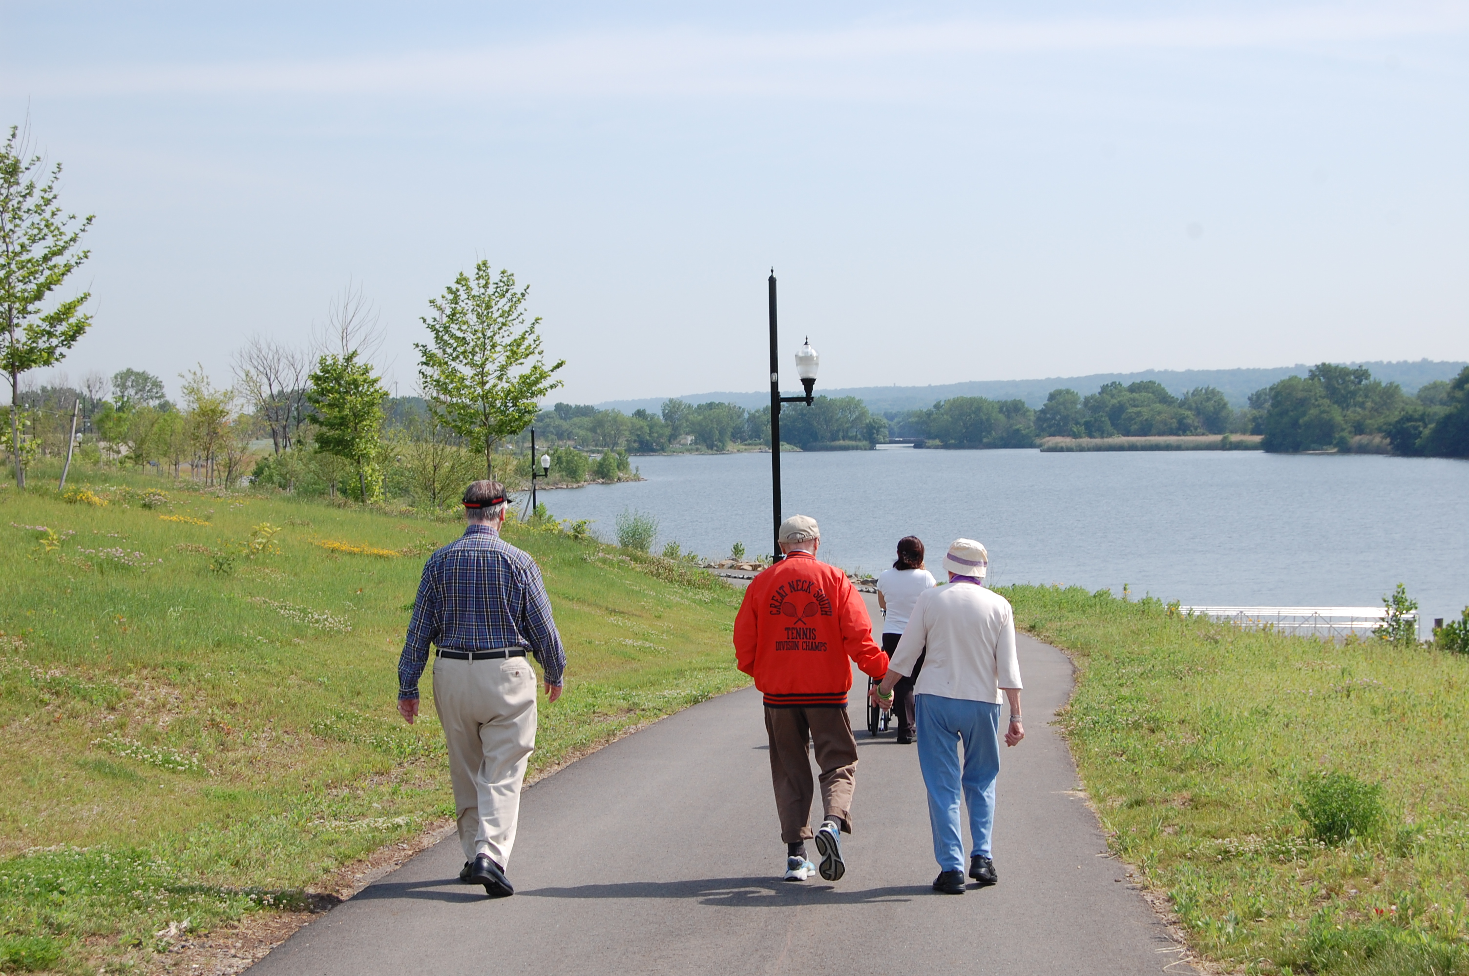
Photo Courtesy of the Actors Fund Home

Slide 15
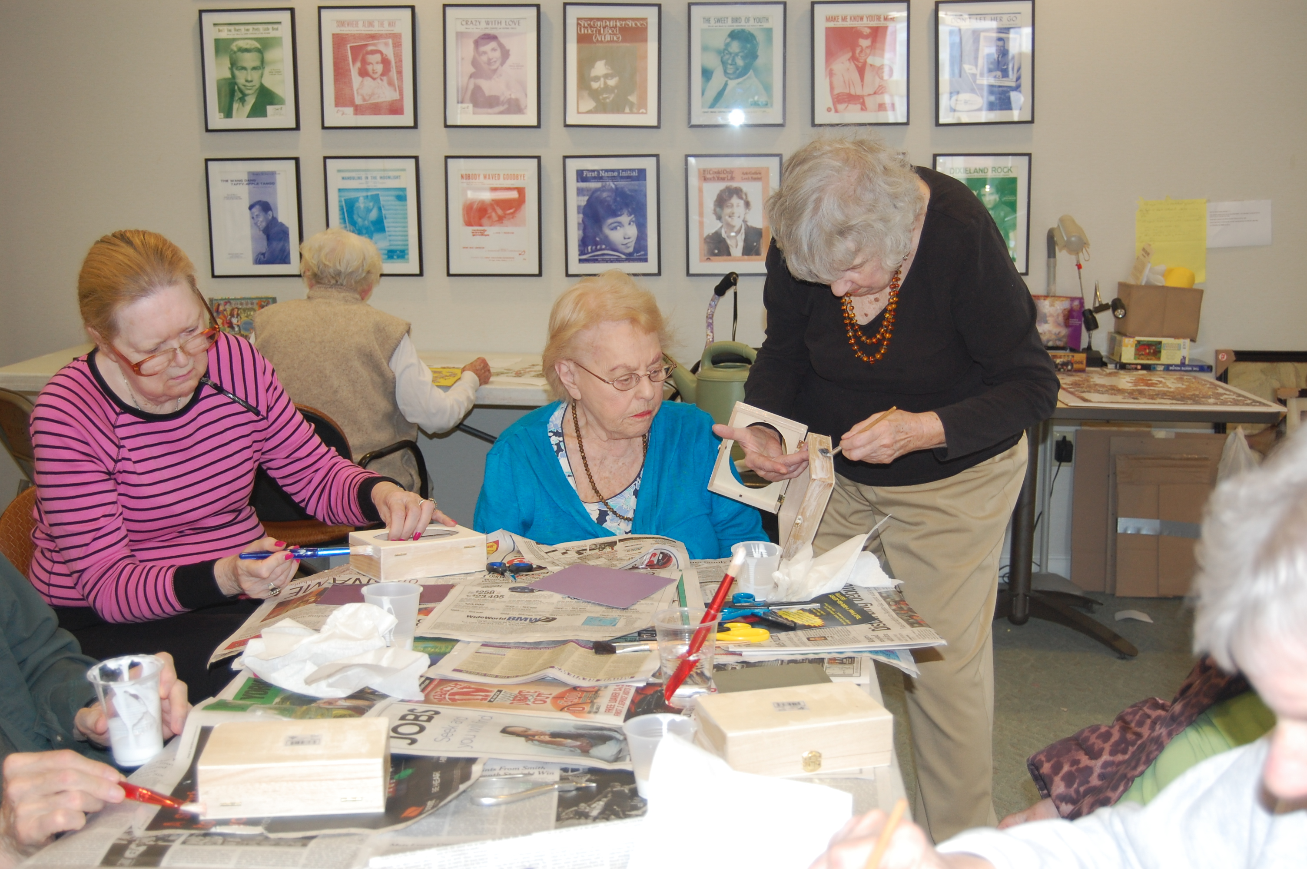
Photo Courtesy of the Actors Fund Home

Slide 16
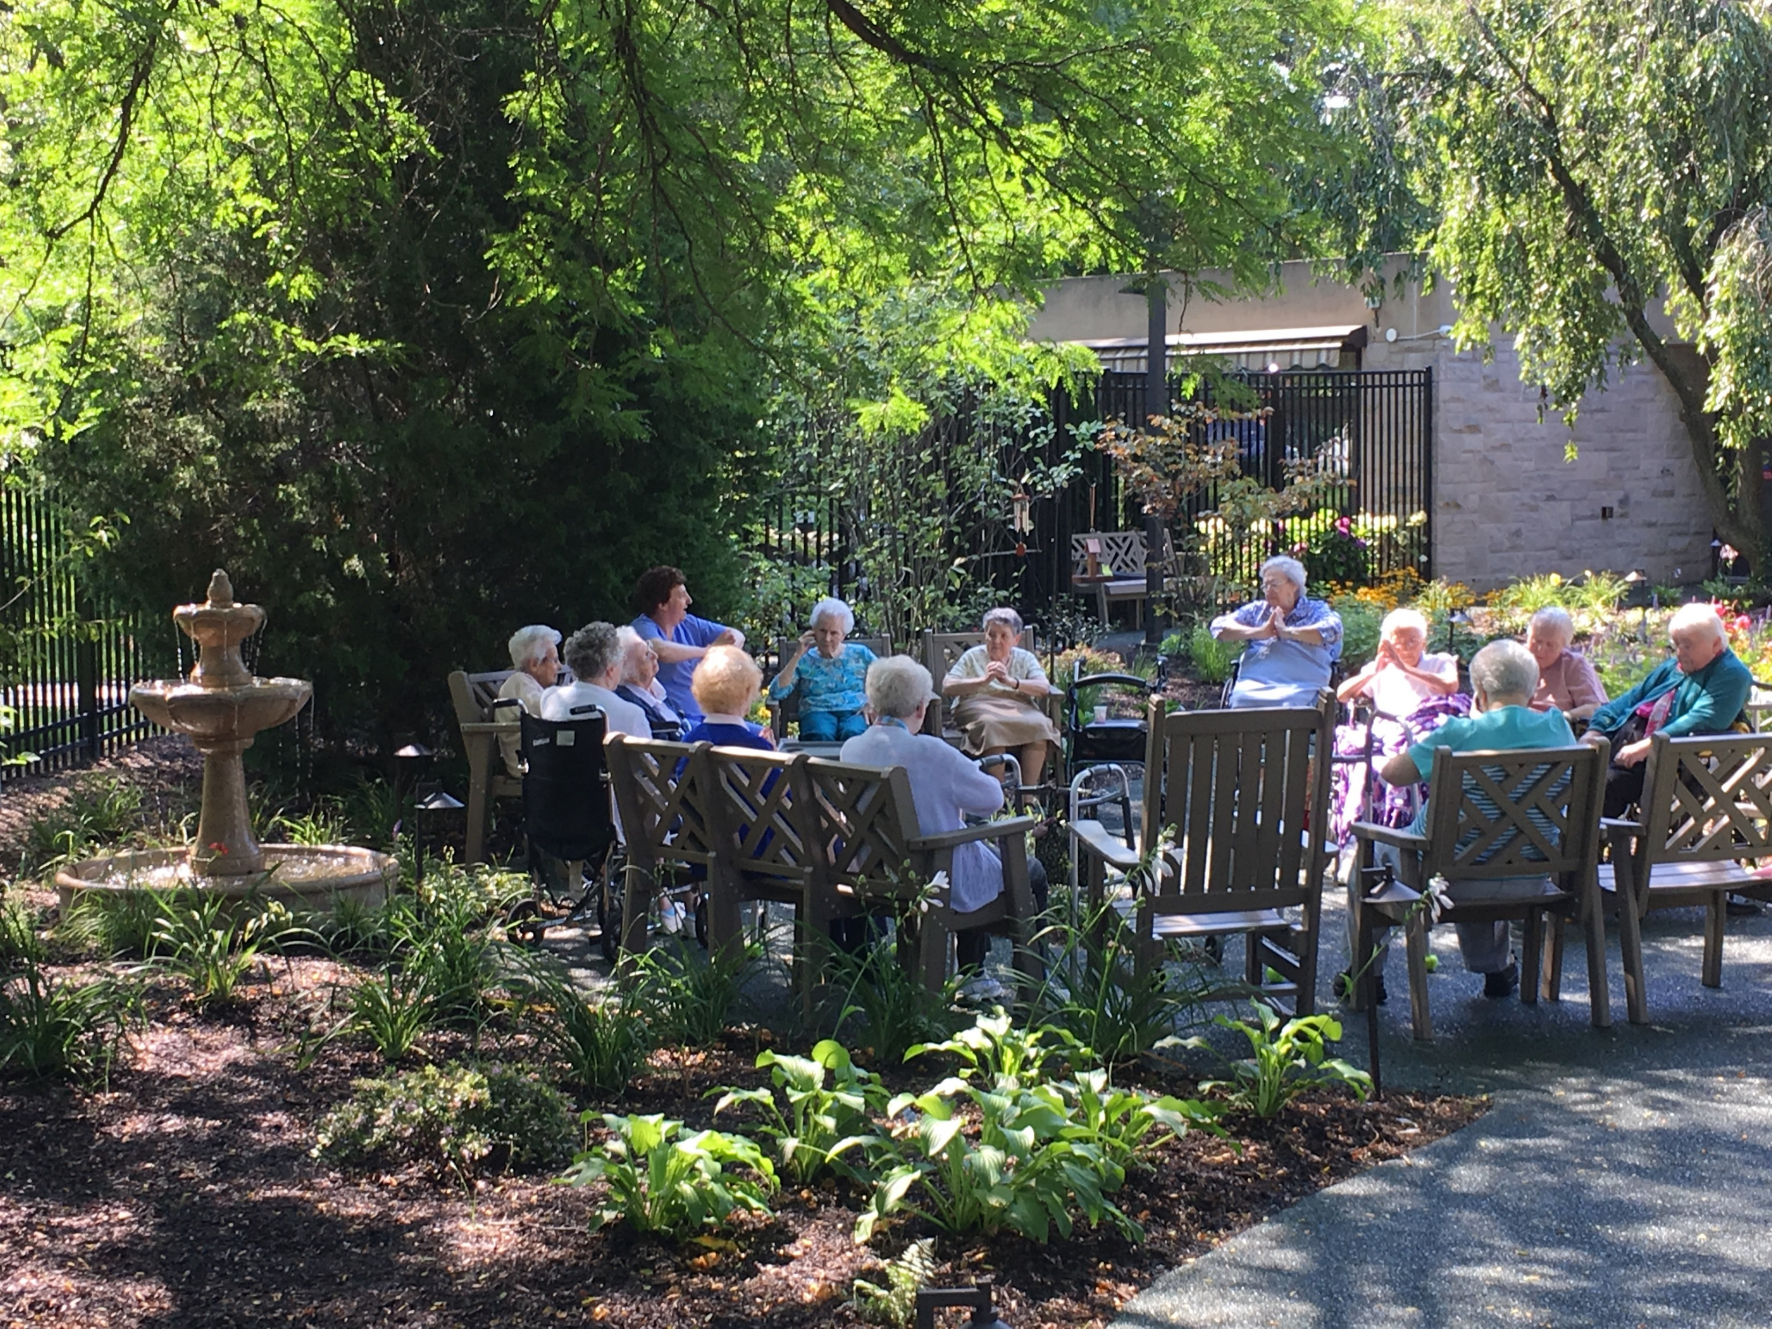
Photo Courtesy of Jack Carman, Design for Generations

Slide 17
Recognizing Cultural Bias

Slide 18
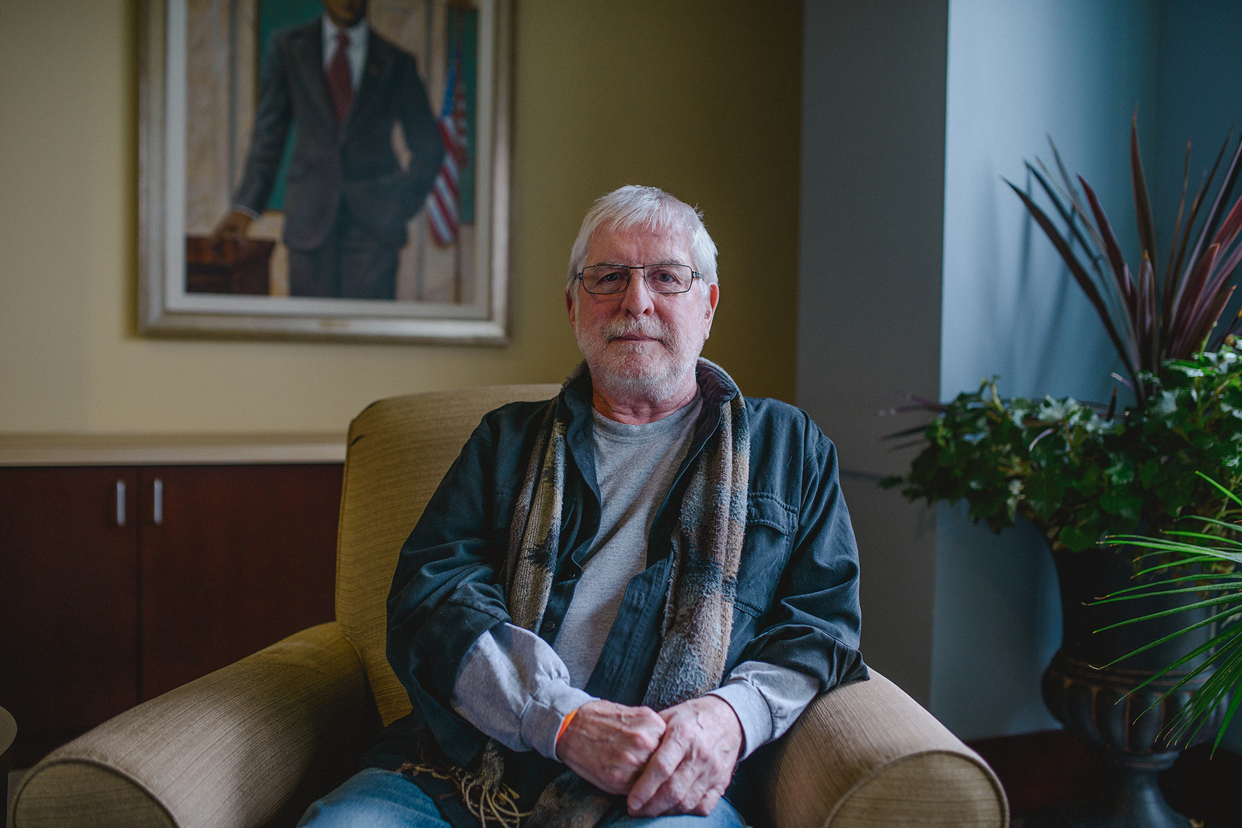
Photo Courtesy of Freedomforallamericans.org

Slide 19
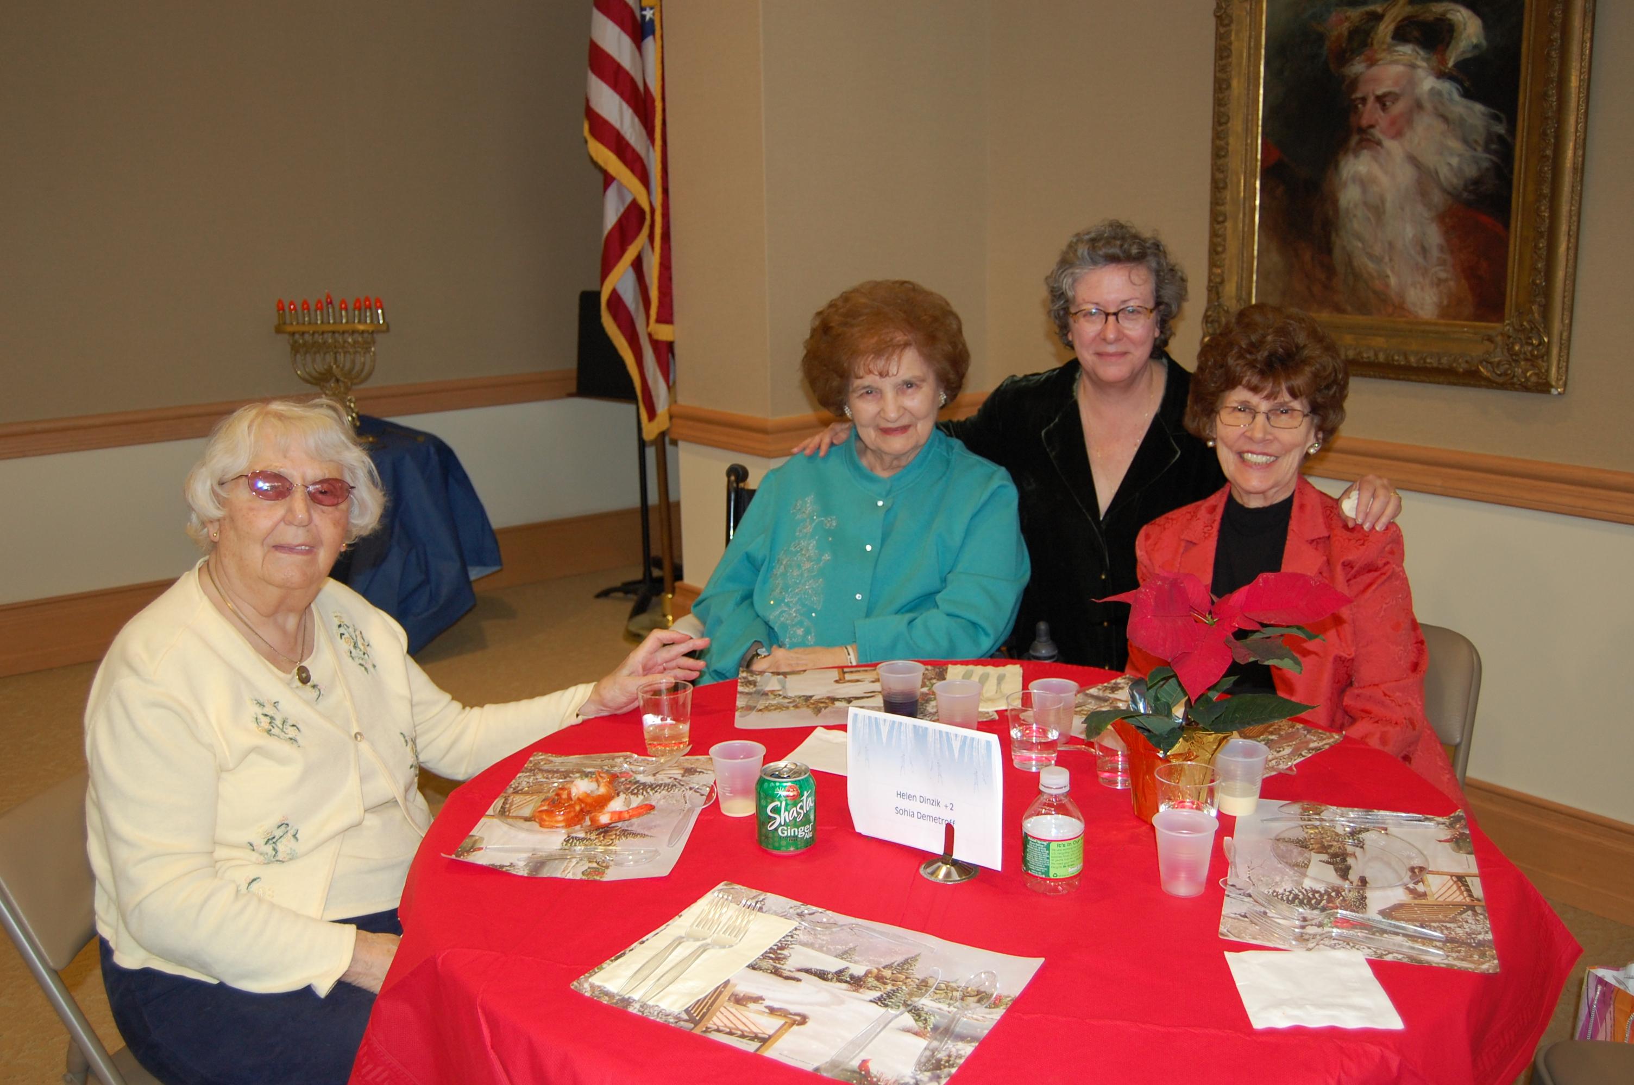
Photo Courtesy of the Actors Fund Home

Slide 20
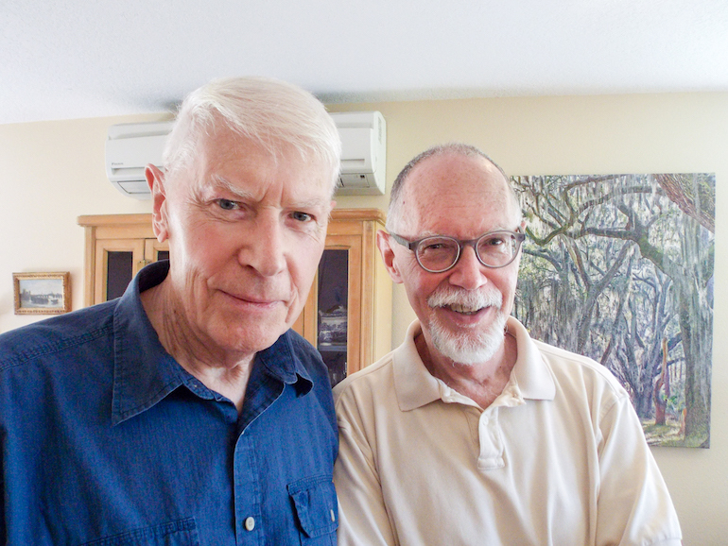
Photo Courtesy of PBS.org

Slide 21
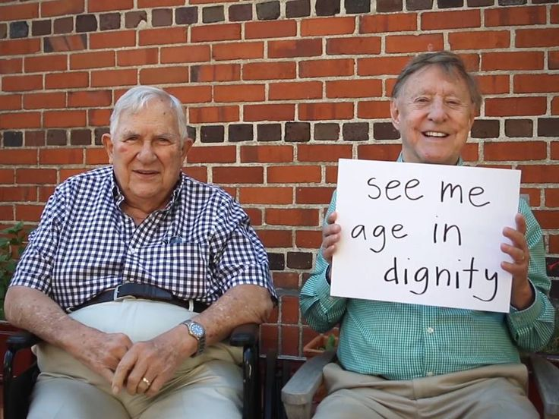
Photo Courtesy of Pinterest

Slide 22
Resources:
ORGANIZATIONS
Services and Advocacy for LGBT Elders (SAGE): www.sageusa.org
Leading Age: ACL Learning Tool: http://www.leadingage.org/members/lgbt-new-cms-training-tool-needs-and-rights-older-adults%C2%A0
National Health LGBT Learning Center – The Fenway Institute: https://www.lgbthealtheducation.org/
Fenway Guide To Lesbian, Gay, Bisexual, And Transgender Health, 2nd Edition: https://store.acponline.org/ebizatpro/Default.aspx?TabID=251&ProductId=21572
National Resource Center On LGBT Aging: https://www.lgbtagingcenter.org/
Movement Advancement Project: https://www.lgbtmap.org/file/understanding-issues-facing-lgbt-older-adults.pdf

Slide 23
Resources:
TRAINING AND TECHNICAL ASSISTANCE:
SAGE: www.sageusa.care
National LGBT Health Education Center: https://www.lgbthealtheducation.org/about-us/technical-assistance/
GETTING STARTED
Collecting Sexual Orientation and Gender Identity Data in Electronic Health Records: https://www.lgbthealtheducation.org/wp-content/uploads/Collecting-Sexual-Orientation-and-Gender-Identity-Data-in-EHRs-2016.pdf
A Toolkit for Collecting Data on Sexual Orientation and Gender Identity in Clinical Settings: http://doaskdotell.org/

Slide 24
FOR MORE INFORMATION OR TO SPEAK WITH ANY OF THE PANELISTS:
JORDAN STROHL, MBA jstrohl@actorsfund.org
MARIA PEREZ, MBA mperez@mchny.org
STEVE LEONE, AIA LEED^{AP} sleone@spiezlegroup.com
THANK YOU FOR ATTENDING.

